Slide 1
OMNIFY ANALYSIS
Listing Site Data

Slide 2

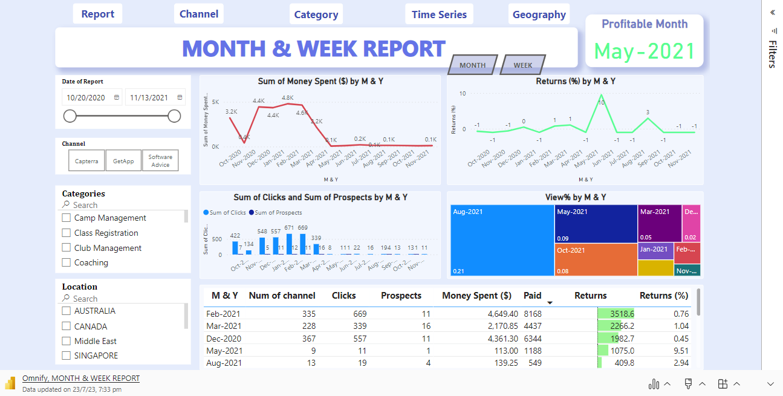
Link : https://app.powerbi.com/reportEmbed?reportId=306caa20-bc2f-4e6f-8cf9-5d722c834cd6&autoAuth=true&ctid=a90703de-3b25-4520-a41b-56a6f50dff03

Slide 3
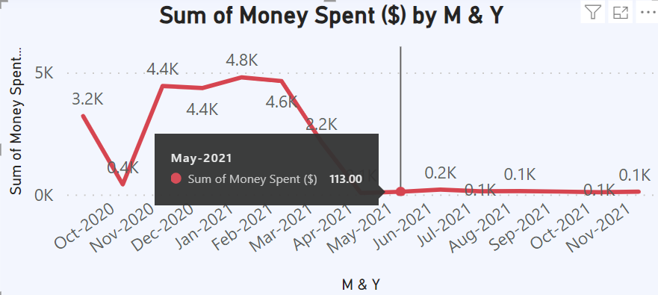
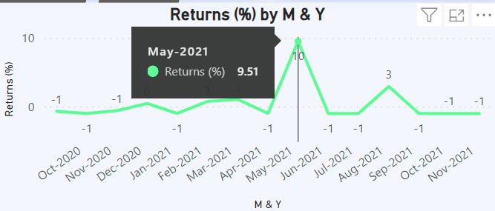
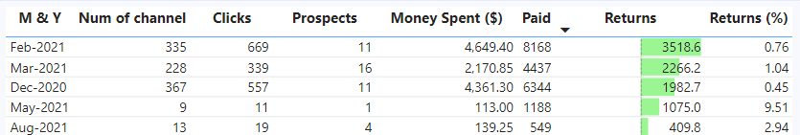
Create a combined report with all key metrics (esp: Spends and Returns %) in a weekly and monthly format. Decide the number of data fields you would like to showcase here.
May is the most profitable month,
With a cost of $ 113 and
Returns of $ 2266.2,
Resulting in a Return% of 9.51% and
A view% of 0.09.

Slide 4
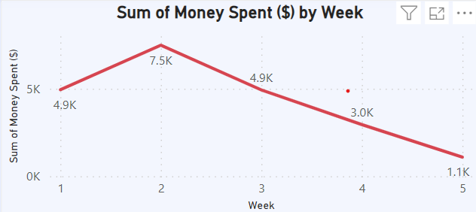
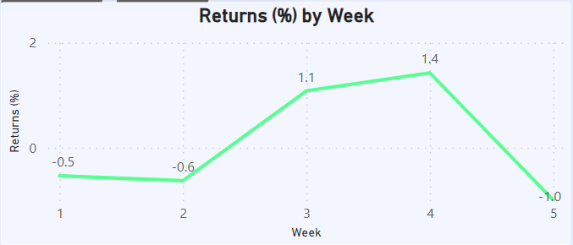
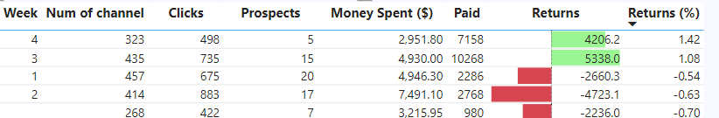
II. Fourth week is the profitable week because of high Return %,
With a cost of $ 2951 and
Returns of $ 4206.2,
Resulting in a Return% of 1.42% and
A view% of 0.02.

Slide 5
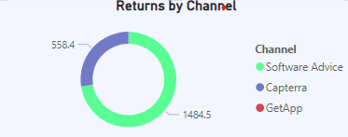
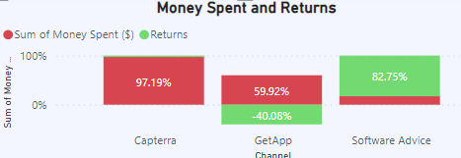
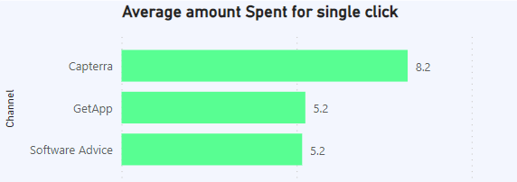
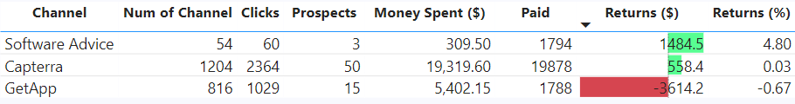
2. Which is the most profitable channel
Software Advice is the most profitable channel with a
Returns of $1484.5
By Spending the amount of $ 309
For Average amount of $ 5.2 per click
Resulting in a Return% of 4.80%

Slide 6
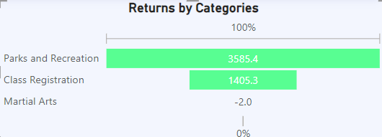
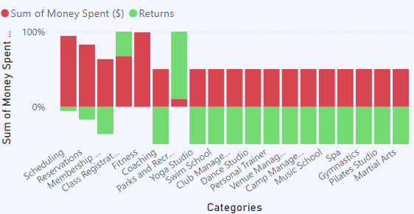
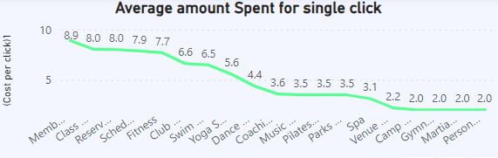
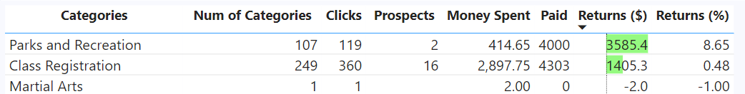
3. Which category is most profitable
Parks and Recreation is the most profitable category with a
Returns of $ 3585.4
By Spending the amount of $ 414.65
For Average amount of $ 3.48 per click
Resulting in a Return% of 8.65%

Slide 7
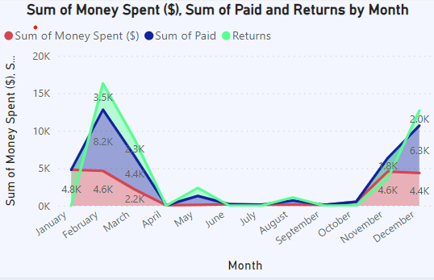
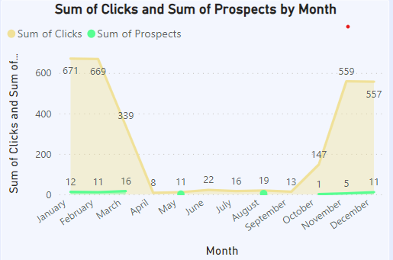
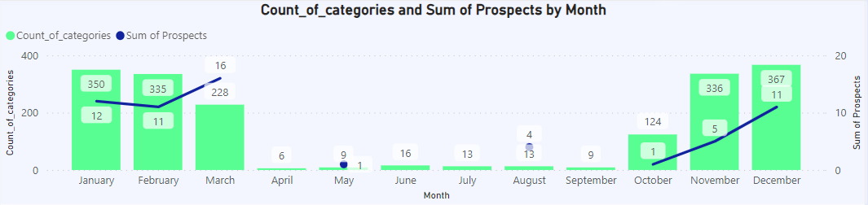
4. Look for insights by analyzing data points on Time Series Graphs
February is the highly active month with a
Returns of $ 3.5k
By Spending the amount of $ 4.6k
With Prospects of 11 over 669 clicks

Slide 8
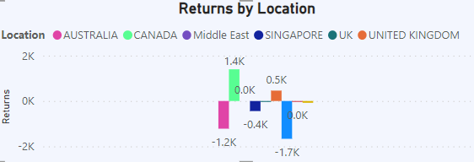
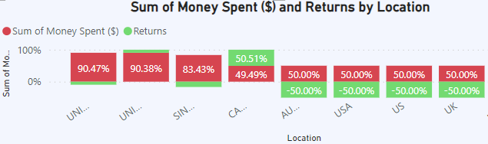
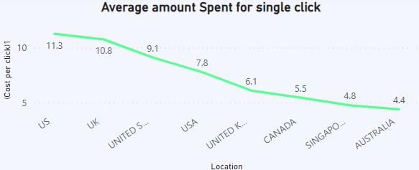
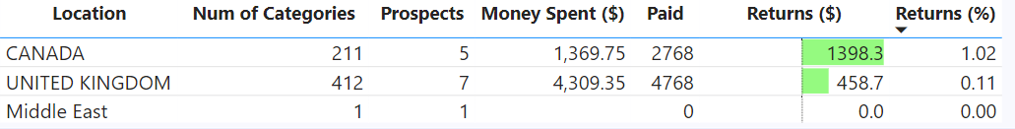
5. Analysis the Impact of geography
Canada is the most profitable location with a
Returns of $ 1398.3
By Spending the amount of $ 1369.75
For Average amount of $ 5.5 per click
Resulting in a Return% of 1.02%

Slide 9
Important Calculations :
Cost per click : Amount spent for single click calculated by dividing the money spent by the people view the ad
DIVIDE(SUM('Listing_Site_Data'[Money Spent ($)]), SUM('Listing_Site_Data'[Clicks]))
Returns : It is the profit percentage calculated by finding the Difference between the money earned and the money spent
(SUM(Listing_Site_Data[Paid]))-(SUM(Listing_Site_Data[Money Spent ($)])
Returns (%) : It is the profit percentage calculated by finding the difference between the money earned and the money spent, and then dividing it by the money spent.
(SUM('Listing_Site_Data'[Paid]) - SUM('Listing_Site_Data'[Money Spent ($)])) / SUM('Listing_Site_Data'[Money Spent ($)]) )
View% : It is the percentage of calculated by finding the difference between the number for people paid for the product and the people view the ad and then dividing it by the people view the ad then added with 1.
(SUM('Listing_Site_Data'[Prospects]) - SUM('Listing_Site_Data'[Clicks])) / SUM('Listing_Site_Data'[Clicks])+1

Slide 10
Thank You

